Slide 1
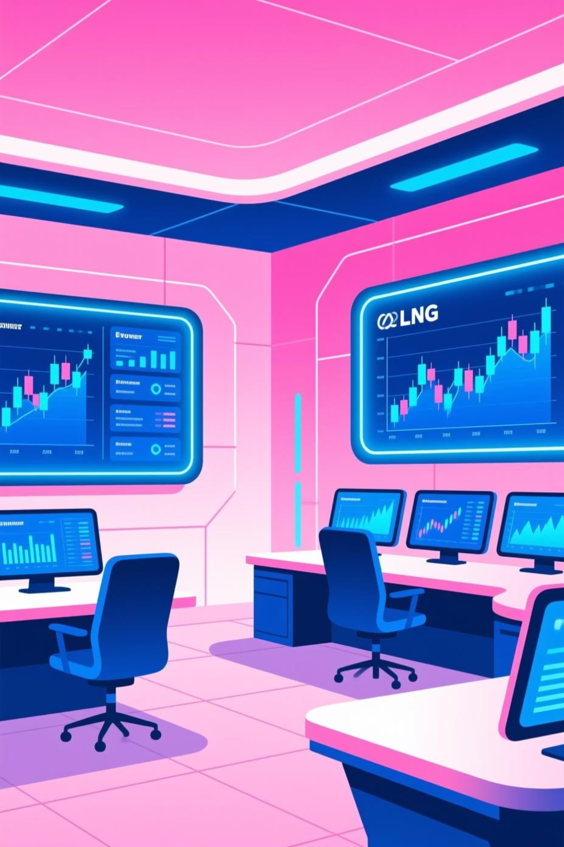
Digital Transformation in Market Analytics
A strategic roadmap for rebuilding market analytics capabilities in Energy World's Middle East division
Presented by:
Rahul Kumar
Principal Data Scientist | Shell

Slide 2
Agenda
Today's Roadmap
Strategic Context & Challenges: Understanding Urgency
6. Risk Management Framework: Identify & Mitigate
Our Strategic Approach: Transformation Framework
7. Stakeholder Engagement Strategy: Engagement Approaches
Available Talent Pool & Core Team Selection: Team Composition
8. Phase 1 Critical Activities: 8-week Timeline
Critical Success Metrics: KPIs and Targets
9. Phases 2, 3, 4: Remaining Phases
Additional KPIs for Transformation: Operational and Business Metrics
10. Building the Future Together: Vision & Conclusion

Slide 3



Strategic Context & Challenges
Critical Situation Analysis
Organizational changes in Middle East division triggered strategic review requiring immediate digital transformation of market analytics capabilities amid significant team restructuring challenges.
Team Exodus Impact
Market Analytics Gap
Organizational Flux
80% of analytics team departed, leaving only 1 analyst with 6 months experience
Urgent need to rebuild digital capabilities for LNG/Gas and Power trading analytics
Strategic review driving need for transformation
Critical knowledge gap in market dynamics and trading patterns
Current manual processes are time-consuming and error-prone
Opportunity to modernize analytics infrastructure
Loss of institutional expertise in LNG/Gas and Power markets
Limited visibility into market trends and trading opportunities
Need for clear roadmap and stakeholder alignment
Urgent need for knowledge capture and team rebuilding
Competitive disadvantage in fast-moving energy markets
Window of opportunity to implement best practices

Slide 4

Our Strategic Approach
01
Assess & Stabilize
Evaluate current capabilities, identify critical gaps, and establish baseline operations
02
Build Foundation
Implement core infrastructure, data pipelines, and analytical frameworks
03
Enable Innovation
Deploy advanced analytics, automation, and AI-driven insights
04
Scale & Optimize
Expand capabilities, refine processes, and drive continuous improvement

Slide 5

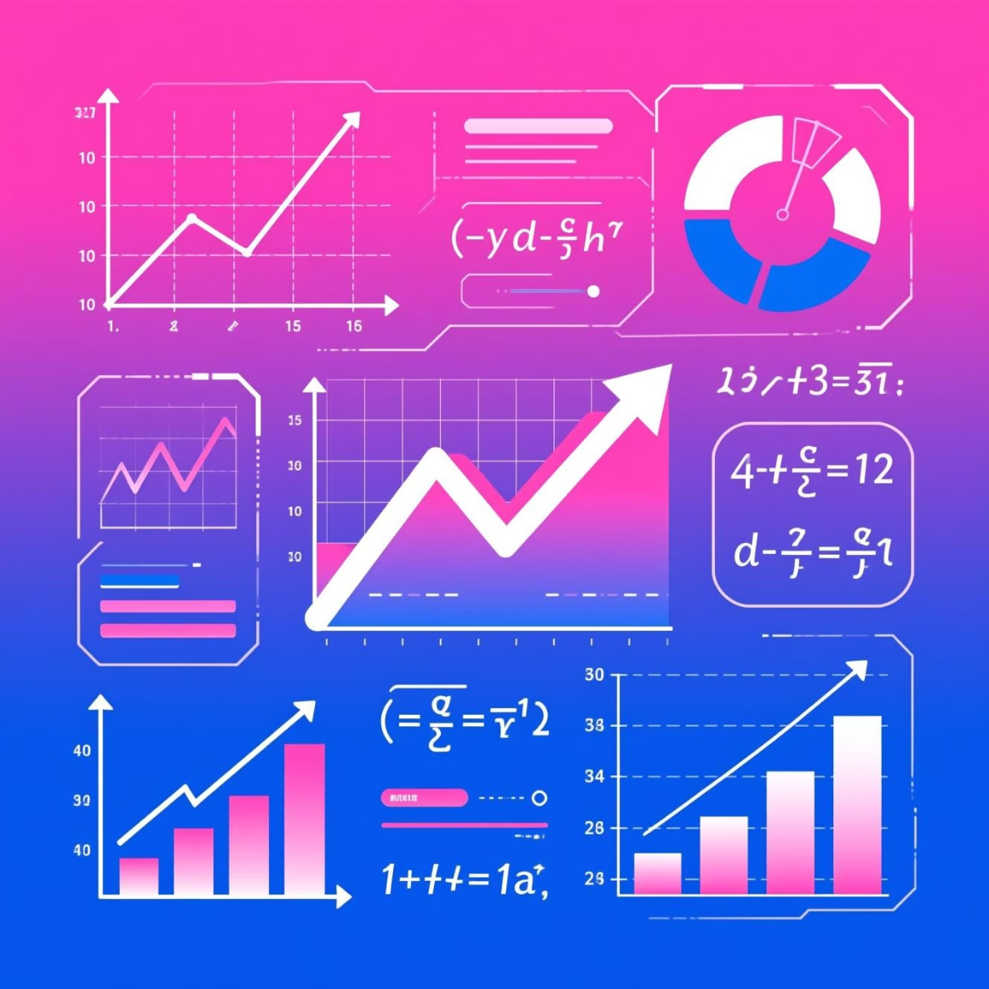




Available Talent Pool
All team members with diverse expertise
Robert
Maxine
Claudia
Programming & Critical Thinking
Math & Stats & Domain Knowledge
Data Visualization & Decision Intelligence
Rajesh
Sakura
Kuan
Data Wrangling & Communication
Database Management & Gen AI & LLMs
Big Data & Cloud & Collaboration

Slide 6



Recommended Core Team for Phase 1
Strategic selection for immediate transformation
From our available talent pool, we've strategically selected three core team members,
whose complementary skills directly address our immediate transformation needs.
Robert
Technical foundation lead with expertise in systems architecture.
Chosen to establish robust infrastructure that can handle high-frequency data volumes from day one.
2
Maxine
Domain expert for commodity trading with deep experience in energy trading.
Selected for her deep understanding of market dynamics and pricing models, critical for initial algorithm development.
1
3
Rajesh
Data wrangling and communication specialist.
Included to ensure seamless integration with existing data warehouses and clear stakeholder reporting during the proof-of-concept phase.

Slide 7
Critical KPIs for Digital Transformation
95%
50%
30%
80%
Data Quality Metrics
Performance Indicators
Insight Generation
User Adoption
Establish baseline data accuracy and implement automated validation processes to ensure reliable market analytics
Measure reduction in processing time and impact through processing efficiency and analytical insight quality improvements
Track new insights and actionable recommendations generated to ensure digital solutions meet business requirements effectively
Track user adoption and satisfaction to ensure digital solutions meet business requirements effectively
Executive dashboard utilization
Real-time data anomaly detection systems
Query response time reduction
Executive dashboard utilization
Training completion metrics
Data lineage tracking implementation
Automated report generation rate
Training completion metrics
Predictive model accuracy scores

Slide 8
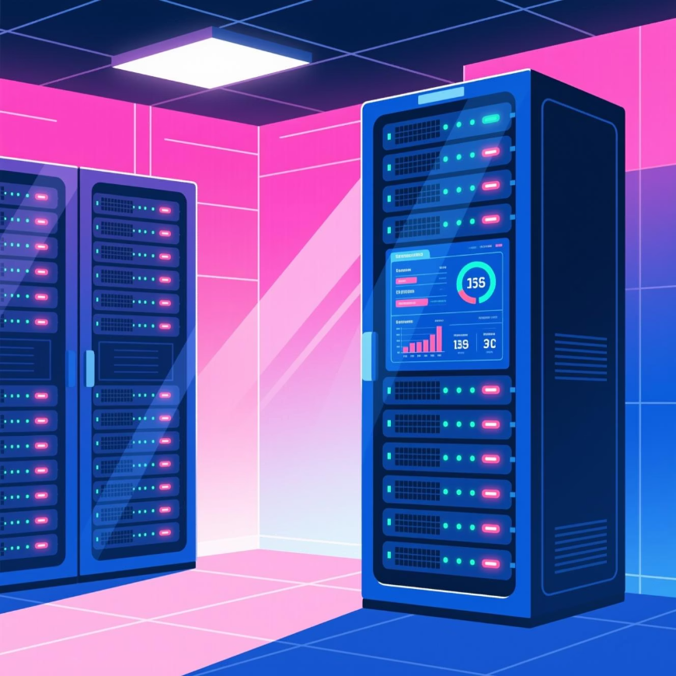
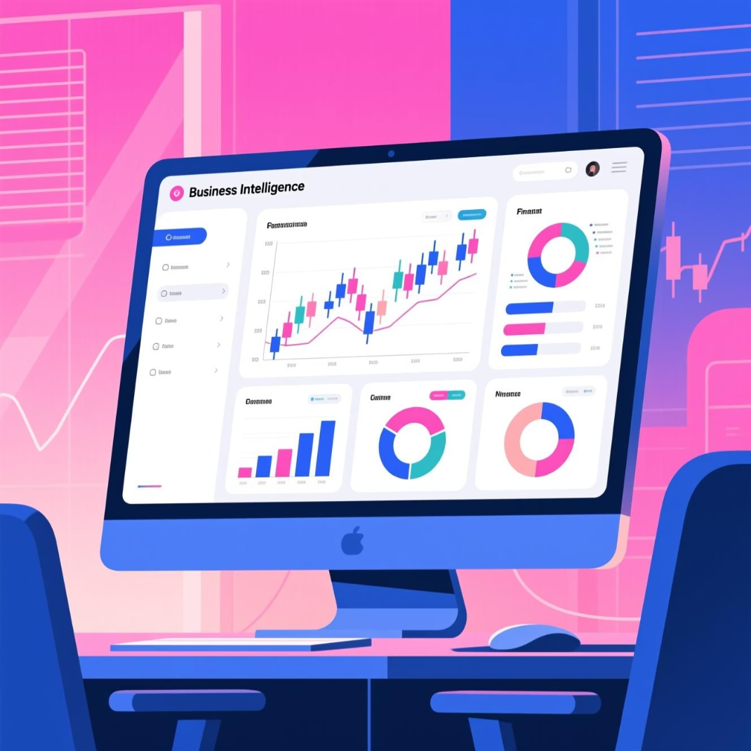

Additional KPIs for Transformation
Operational Excellence
Business Impact
Team Development
System uptime and reliability (99.5% target)
Trading decision support effectiveness
Knowledge transfer completion rate
Market opportunity identification rate
Cross-functional collaboration score
Automated report generation rate
Risk detection and alert accuracy
Capability maturity progression
Data refresh frequency improvements

Slide 9




Risk Management Framework
Knowledge Loss
Data Quality
Risk: Remaining institutional knowledge walks out
Risk: Poor data foundation undermines analytics
Mitigation: Immediate documentation sprint, knowledge capture sessions, retention incentives
Mitigation: Data audit, validation frameworks, quality monitoring dashboards
Stakeholder Resistance
Risk: Low adoption of new tools and processes
Mitigation: Early engagement, co-creation workshops, quick wins strategy

Slide 10








Stakeholder Engagement Strategy
Executive Leadership
Trading Teams
Approach: Monthly steering committee, ROI dashboards, strategic alignment reviews
Approach: Weekly demos, feedback loops, co-design sessions for analytics tools
Risk & Compliance
IT & Infrastructure
Approach: Governance framework alignment, audit readiness, control validation
Approach: Technical working groups, architecture reviews, integration planning

Slide 11
Phase 1 Critical Activities
Weeks 1-2: Discovery
1
Stakeholder interviews, current state assessment, data landscape mapping, pain point identification
2
Weeks 3-4: Foundation
Data quality audit, infrastructure requirements, tool evaluation, governance framework design
Weeks 5-6: Quick Wins
3
Automate critical reports, build initial dashboards, establish data pipelines, demonstrate value
4
Weeks 7-8: Roadmap
Detailed transformation plan, resource requirements, budget proposal, stakeholder alignment

Slide 12




Building the Future Together
Stabilize
Establish reliable operations and data foundation
Innovate
Deploy advanced analytics and automation
Transform
Scale capabilities and drive competitive advantage
With the right team, clear metrics, and proactive risk management, we will rebuild market analytics capabilities while positioning Energy World for digital leadership in the Middle East energy markets.

Slide 13

Phase 2: Build Foundation
Core Deliverables
Timeline & Resources
Data pipeline architecture and implementation
Duration: 8-12 weeks
Market data integration (LNG, Gas, Power)
Team: Maxine, Rajesh, Claudia + 1 data engineer
Analytics platform setup and configuration
Budget: $150K-200K
Reporting infrastructure and dashboards
Success criteria: 90% data quality, 3 automated reports live

Slide 14

Phase 3: Enable Innovation
Advanced Capabilities
Timeline & Resources
Machine learning models for price forecasting
Duration: 10-14 weeks
Automated anomaly detection and alerts
Team: Maxine, Rajesh, Claudia + 1 ML engineer + 1 domain consultant
Predictive analytics for market trends
Budget: $200K-250K
AI-driven insights and recommendations
Success criteria: 3x insight velocity, 85% user adoption

Slide 15

Phase 4: Scale & Optimize
Expansion Initiatives
Timeline & Resources
Extend analytics to additional markets and products
Duration: 12-16 weeks
Team: Expanded team with additional analysts and engineers
Build self-service analytics capabilities
Implement continuous improvement processes
Budget: $250K-300K
Success criteria: 50% time reduction, 99.5% system uptime, full market coverage
Establish center of excellence for analytics

Slide 16

Thank You & Q&A
I appreciate your time and attention today as we outlined our digital transformation strategy for market analytics. We are now open for any questions you may have.
Questions?
Contact Information
Rahul Kumar | Principal Data Scientist
rahul.kumar4@shell.com
+91-9643992439
www.shellcom

